Slide 1
Social Media Analytics
JOUR479V/779V – Computational Journalism
University of Maryland, College Park
Nick Diakopoulos, Ph.D.

Slide 2

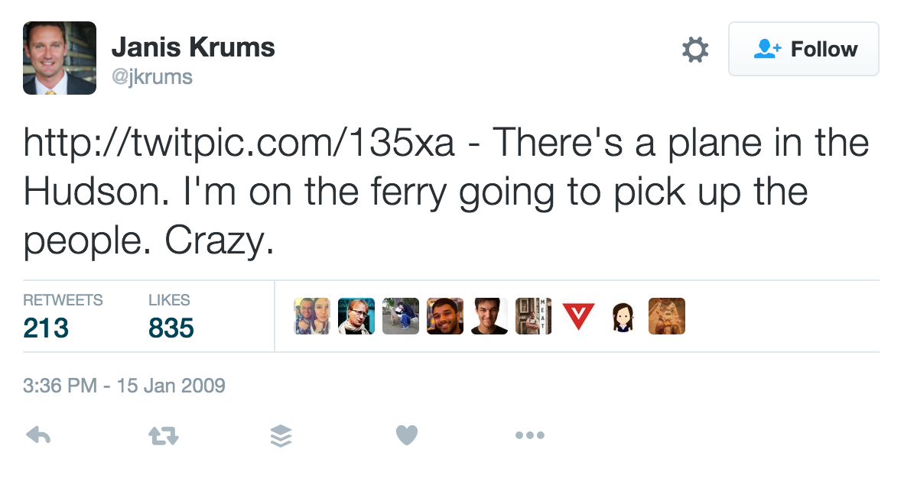
Notes:
Who remembers this photo? Was taken Jan 15, 2009 and was one of the first photos taken of the plane crash on the hudson river

Slide 3
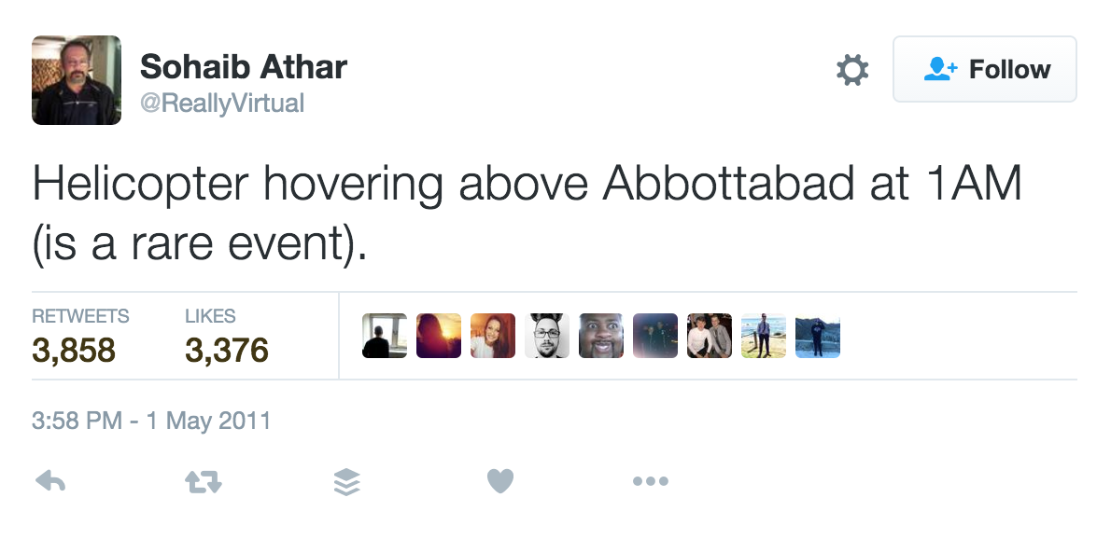
Notes:
Useful info doesn’t ONLY come in the form of images.
This guy unknowingly live-tweeted the raid that ultimately killed osama bin laden.

Slide 4
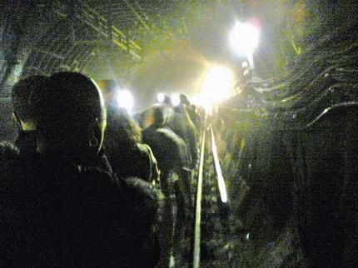
7/7 Bombings
BBC Received
30 video clips
300 emails with avg. 3 photos each
Notes:
July 7, 2005. The BBC said it received around 30 video clips from members of the public and more than 300 e-mails containing an average of three images each on the day of the attacks.

Slide 5
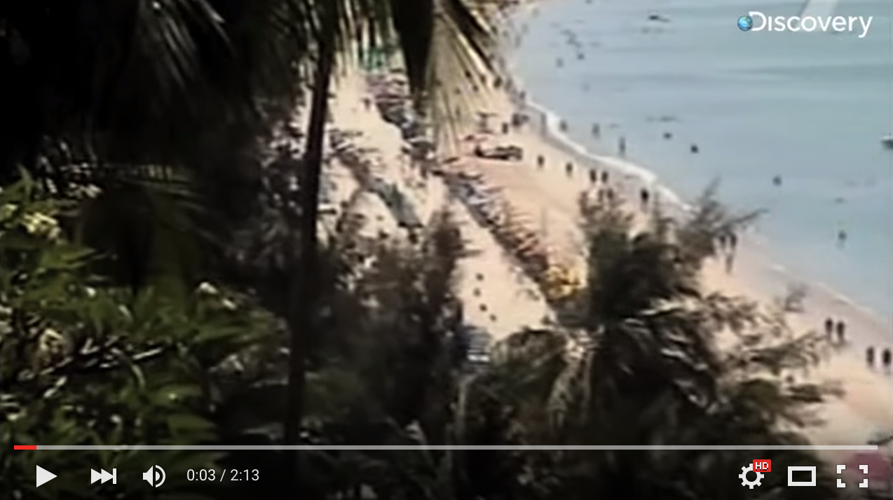
https://youtu.be/--a6wD5jRSs?t=3
Notes:
And even before that people were sharing photos / videos during the 2004 Tsunami. Information coming in from citizen journalists not just via social media but also
https://youtu.be/--a6wD5jRSs?t=3

Slide 6
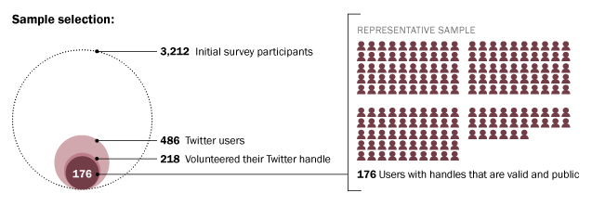
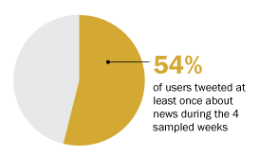
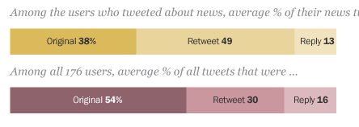
Twitter Use for News
http://www.pewresearch.org/fact-tank/2015/08/19/how-do-americans-use-twitter-for-news/
Notes:
In one study from Pew they found that about 15% of users sampled nationally were on twitter, and of those about 54% tweeted once about news within their sampling periods.
People tend to RT more about news, but there’s still a substantial portion of original tweets there. That’s the original information that can feed social journalism. The huge scale of twitter means computational means are needed to listen to all of that content, sort it and rank it, and evaluate it for newsworthiness.

Slide 7
Platforms
Twitter, Facebook, Instagram, LinkedIn, Reddit, YouTube … what else? What type of info might come from any of these?
It really depends on what kind of news you’re looking for – different countries have different platforms that are dominant

Slide 8
Social Listening Tools
Facebook Signal
Twitter Curator
Geofeedia
Dataminr
Notes:
Useful for finding trends, geolocated information, event detection, alerts.
Some of these can be used for other purposes. What might be other application domains besides news?

Slide 9
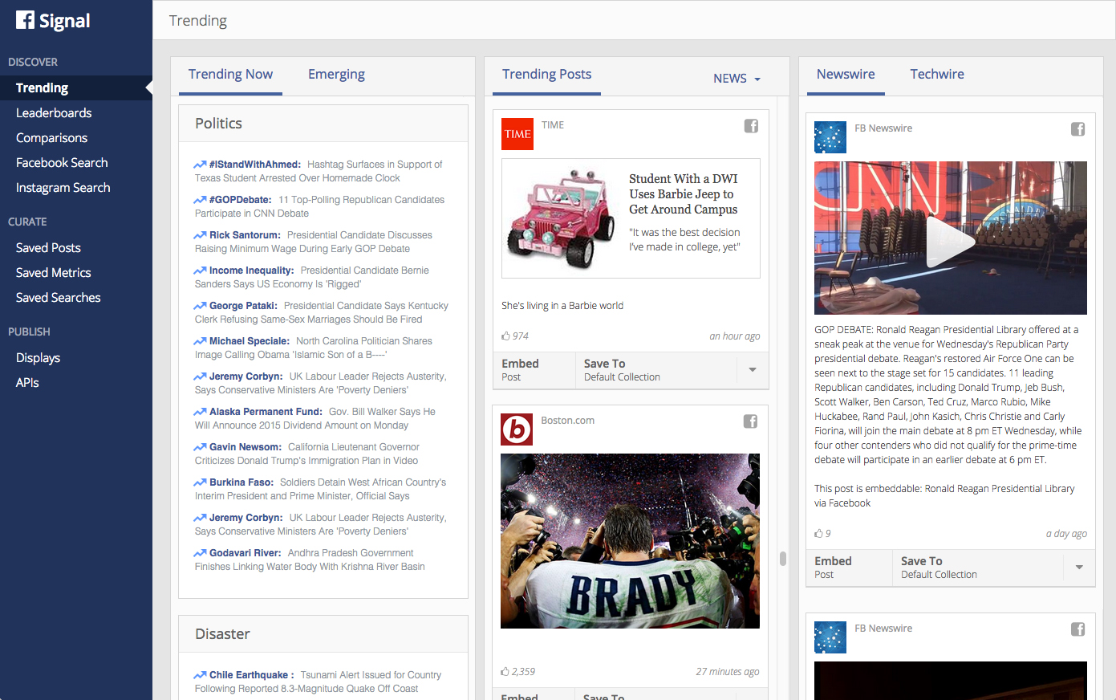
https://www.facebook.com/facebookmedia/get-started/signal
Notes:
FB signal is another social listening tool that supports discovering trending topics, tracking names entities in terms of mentions, and searching FB or instagram.

Slide 10
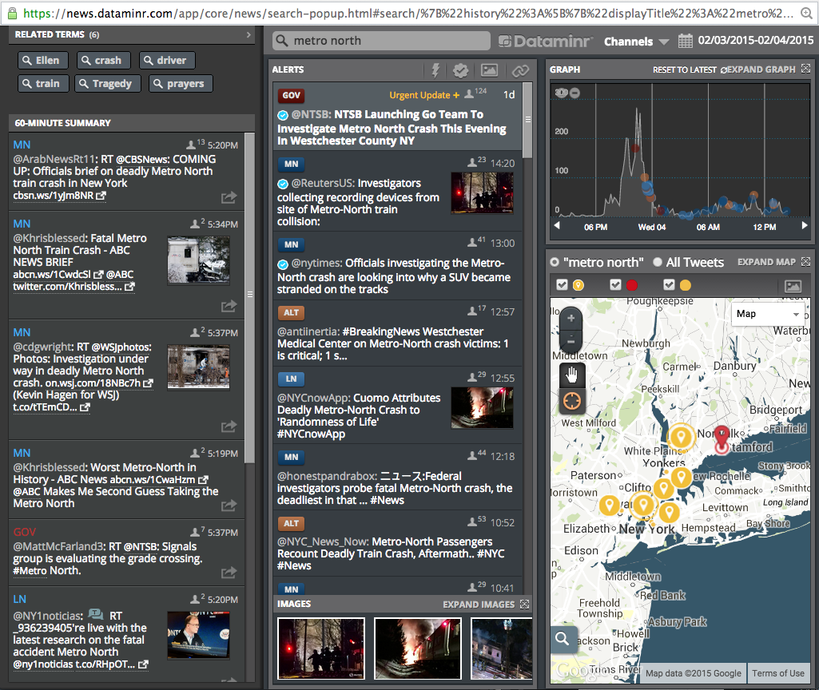
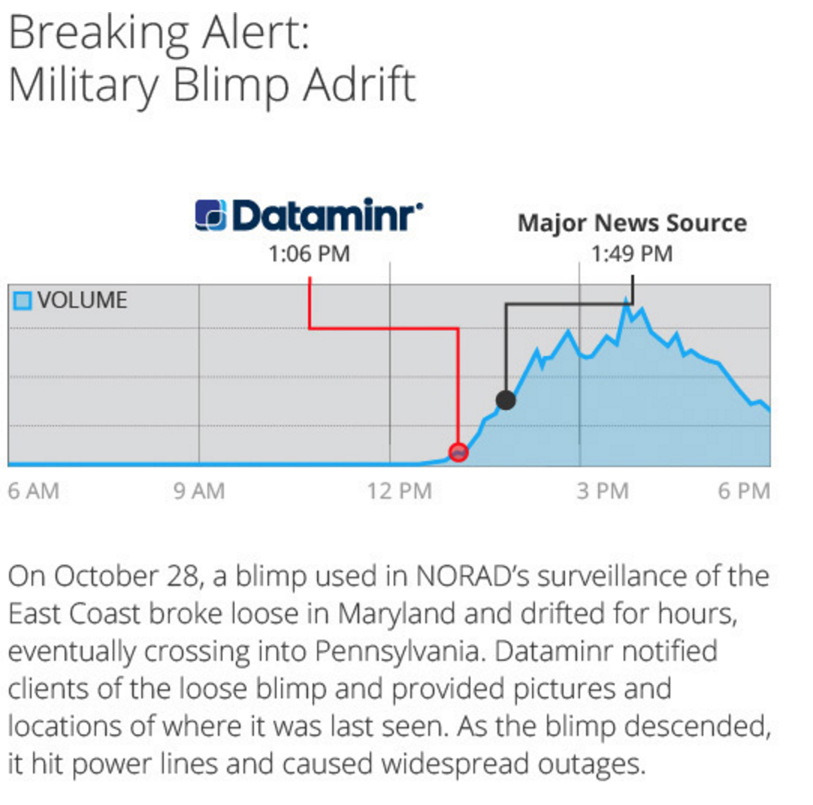
Dataminr
Notes:
As of April 2015 Dataminr was used by 200 news orgs

Slide 11
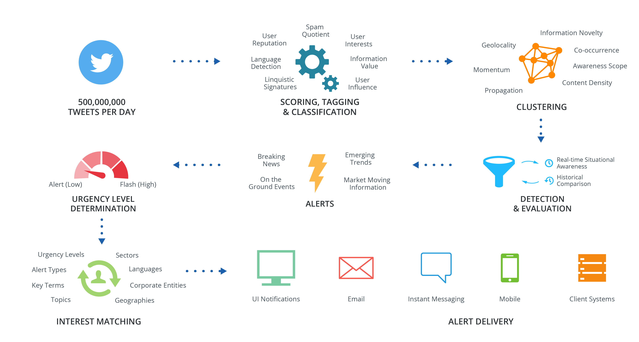
Dataminr Process
Notes:
Where are editorial decisions in this process?

Slide 12
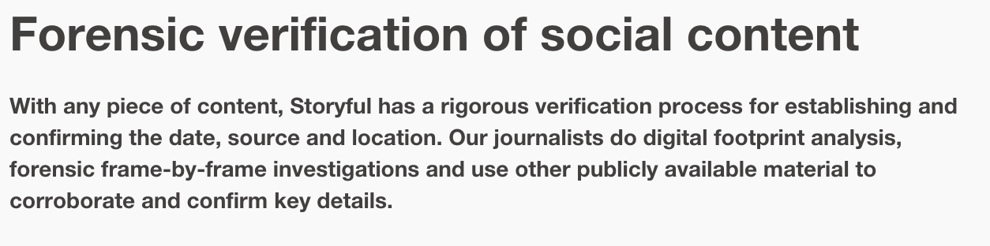
Content Verification
Social Media Forensics
Trust, expertise evaluation, eyewitnesses, debunking, independence, provenance
Storyful
https://storyful.com/case-study/forensic-verification-of-social-content/
Notes:
Interesting case study that looks at some of the specific techniques.
Other techniques involve using reverse image search, looking at more social media context (e.g. age of account) and who they’re connected to.

Slide 13
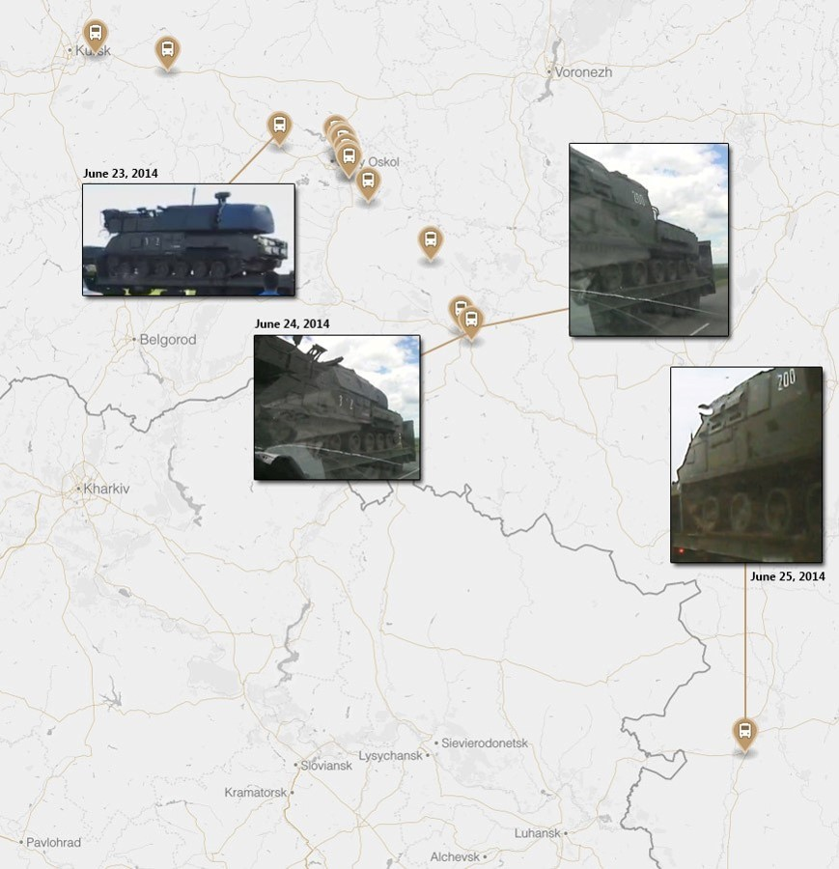
https://www.bellingcat.com/news/uk-and-europe/2015/10/08/mh17-the-open-source-evidence/
Notes:
Bellingcat: https://www.bellingcat.com/news/uk-and-europe/2015/10/08/mh17-the-open-source-evidence/
Pretty amazing step by step analysis of open source intelligence, mainly imagery that tracks the BUK missile system that was used to shoot down MH17. Primarily I believe these efforts happen through a lot of manual effort.

Slide 14
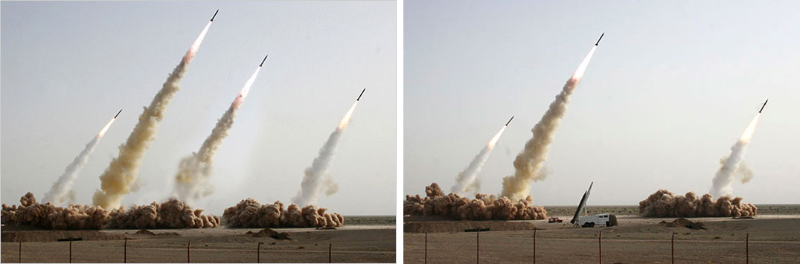
Photo Tampering Detection
http://www.fourandsix.com/blog/2013/4/2/the-pixel-arms-race.html
Notes:
An image of an Iranian missile test appeared on the front page of many major newspapers. The image was from the web site of Sepah News, the media arm of Iran’s Revolutionary Guards. After the publication of this photo, it was revealed that the second missile from the right was digitally added to the image in order to conceal a missile on the ground that did not fire.
This type of manipulation can be found via software that can look at repeated pixels or statistical discontinuities in the pixels that suggest it is not “natural”.

Slide 15
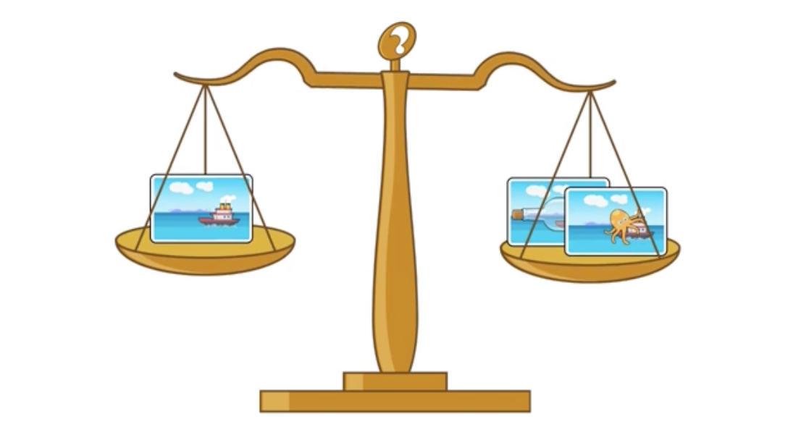
Izitru
http://www.izitru.com/

Slide 16
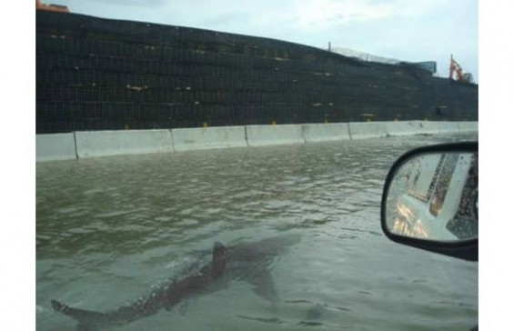
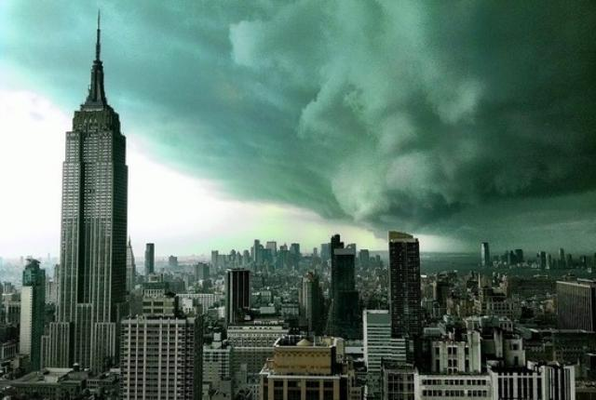

Which is real hurricane Sandy photo?
Notes:
Answer to the question: None of them are from Sandry. The last image is actually real but it is from a tornado brewing not from the hurricane.
Another issue that journalists have to deal with are rumours. Stuff goes viral all the time and journalists need to have their guard up to investigate the real from the fake.

Slide 17
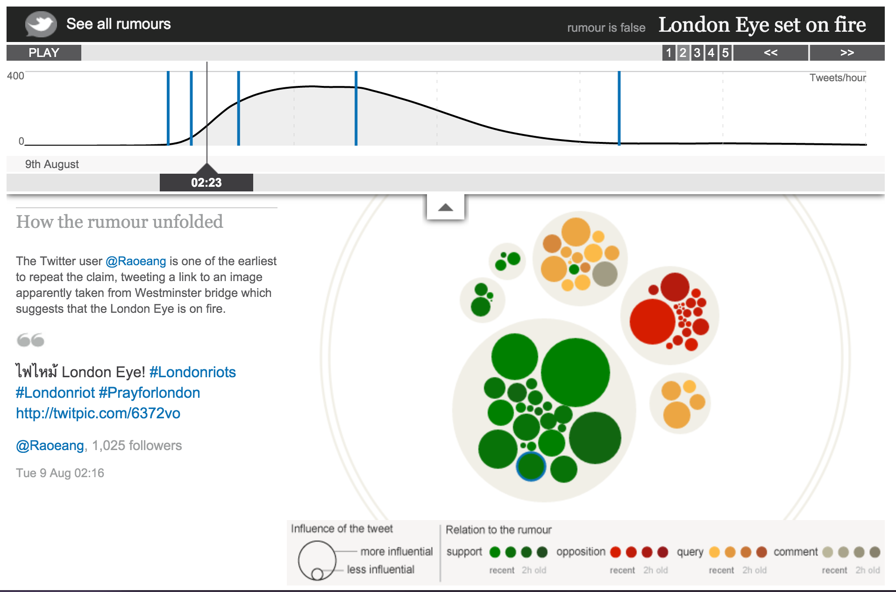
http://www.theguardian.com/uk/interactive/2011/dec/07/london-riots-twitter
Notes:
Really great interactive from Guardian that shows the evolution of rumors. In the London eye example you can see the oposition basically wins out but in others you see that it doesn’t.

Slide 18
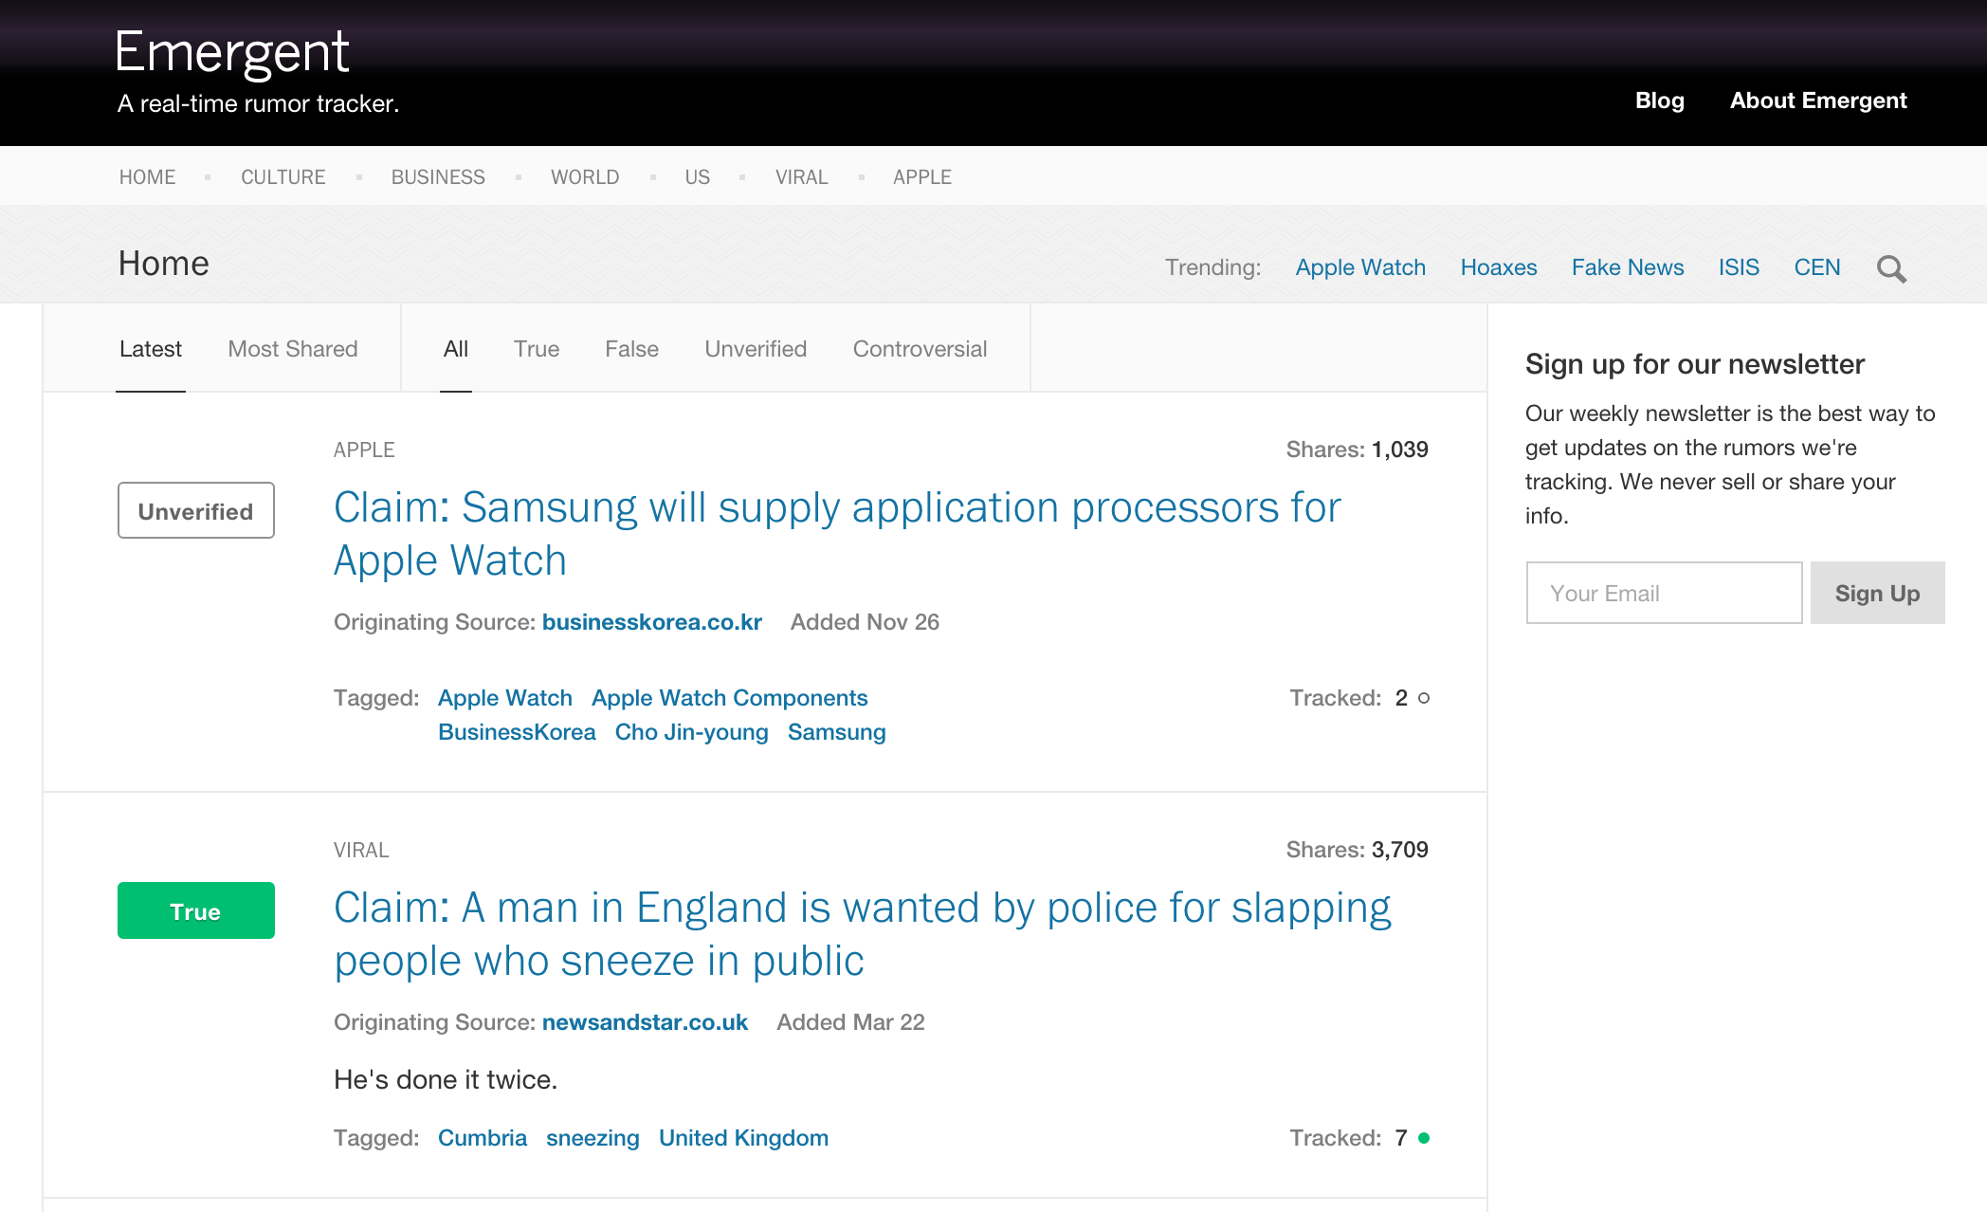
http://www.emergent.info/

Slide 19
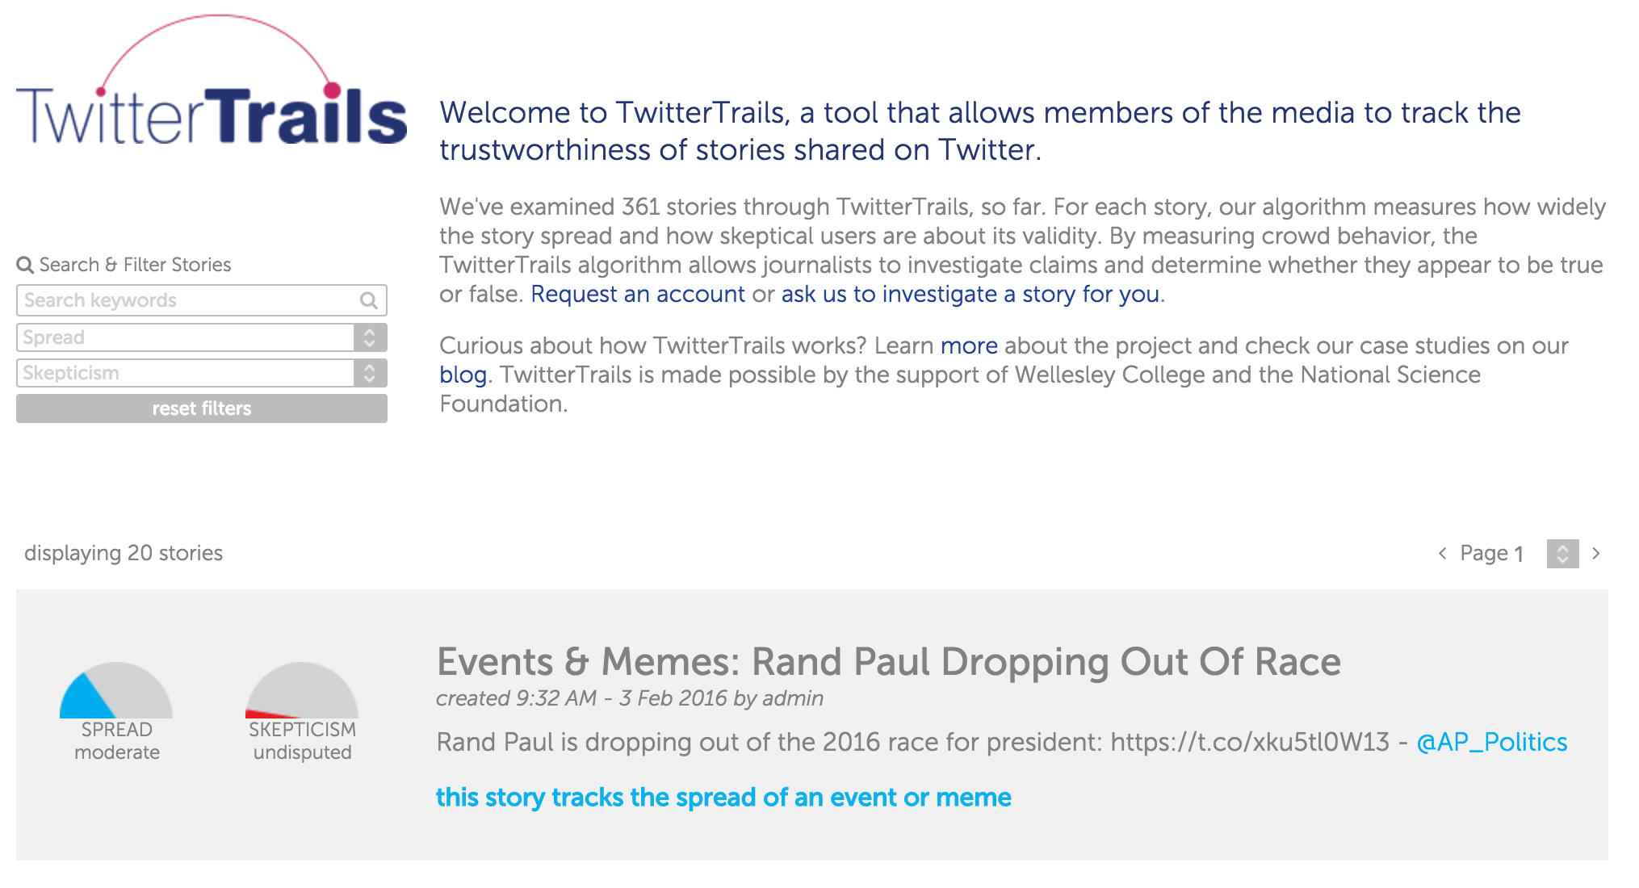
http://twittertrails.com/
Notes:
There are efforts out there to try to catalogue rumours and collect data that can be used to predict or identify events that are more likely to be rumors based on the spreading pattern or sentiment (e.g. skepticism) expressed.

Slide 20

Notes:
Lots more methods for doing social media verification can be found in the verification handbook.

Slide 21
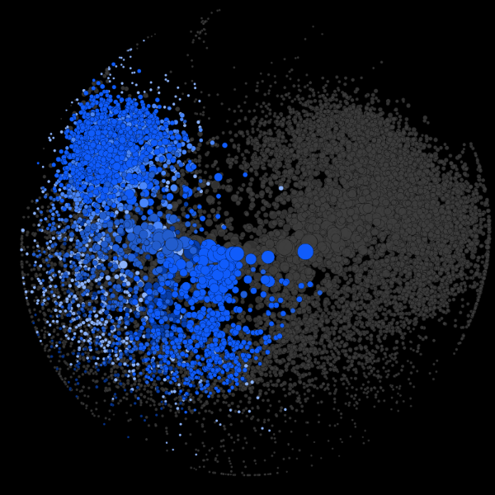
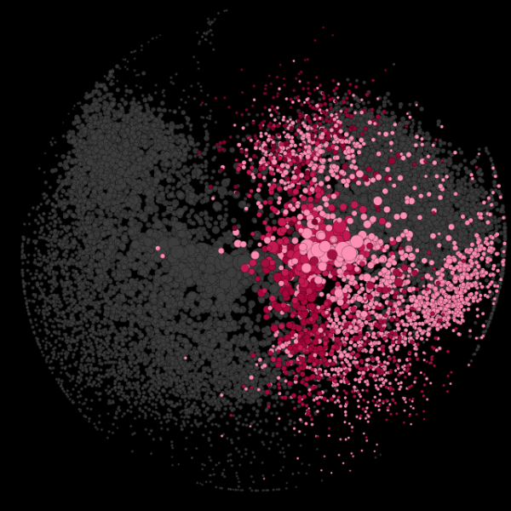
Network Analysis
Notes:
http://www.graphika.com/blog/2015/7/15/understanding-political-polarization-on-twitter
Network analysis: Can cluster people based on who they’re following, or what news they’re paying attention to. These maps show the most connected accounts following any of the US senators on Twitter.
The left is discussing:
the Supreme Court’s decision on gay marriage
whether states should take down confederate flags across the country
and a recent congressional decision to extend the ban on CDC research of gun violence.
The right is discussing:
the nuclear talks in Vienna
defense and criticism of Donald Trump
and many articles relating to immigration issues (from Latinos officially outnumbering whites in California to Senator Jeff Sessions’ crackdown on city officials who harbor illegal immigrants in Alabama).
“There is little crossover between these communities, both in terms of the specific content they share and the larger media narratives that are discussed. As is evident from the network of US Senate followers, few people bridge the divide between conservative and liberal.”

Slide 22
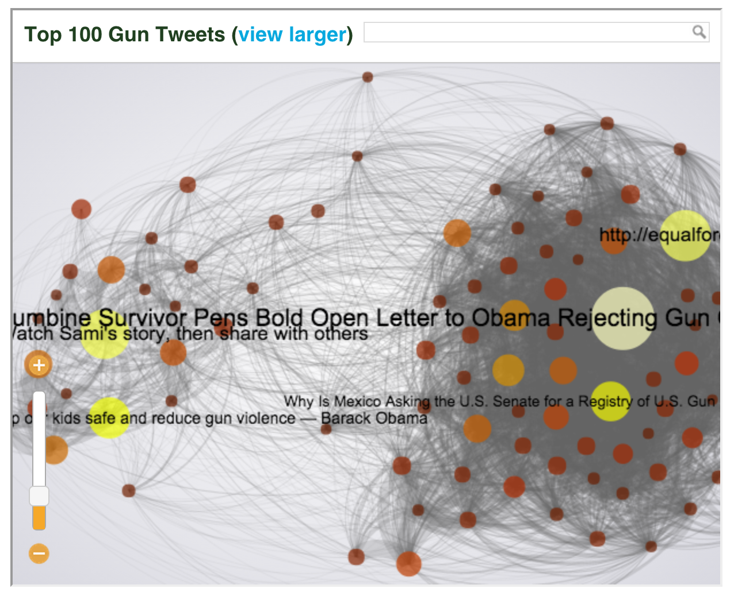
http://www.theatlantic.com/national/archive/2013/02/the-whole-dysfunctional-national-conversation-about-guns-on-twitter-in-one-interactive-graph/273499/
Notes:
Network analysis can actually make a story sometimes. Networks can also be useful for illustrating how people are talking about the news.
Nodes are top links shared on twitter about gun violence. An edge is drawn only if the two links were shared by the same person.

Slide 23
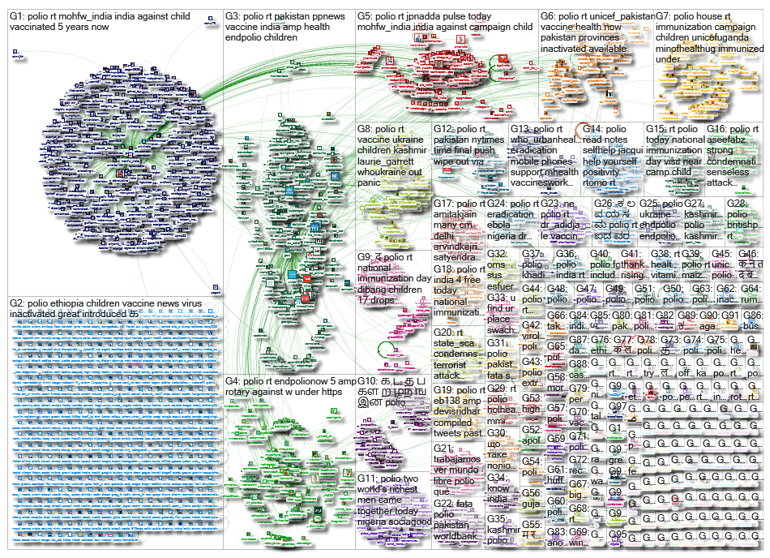
http://www.nodexlgraphgallery.org/Pages/Graph.aspx?graphID=61755
Notes:
http://www.nodexlgraphgallery.org/Pages/Graph.aspx?graphID=61755
NodeXL isn’t as polished, but it’s free and quite powerful to beginning to develop an understanding of the network around an event.

Slide 24
Implications of Social Listening
Verification at scale is hard
Algorithmic biases in selection / filtering
Ethics / privacy of use of volunteered information in news reporting
Vicarious trauma for difficult topics like war reporting via social

Slide 25
Readings
The new importance of ‘social listening’ tools
What types of stories might these tools miss?
How is the use of these tools likely to bias news coverage?
How to tell whether a Twitter user is pro-choice or pro-life without reading any of their tweets
Why are Twitter trends relevant to this story?
What’s the power of individuals’ social networks exposed here?
Notes:
Could miss foreign language media, or stories that build slowly and don’t have high “social velocity”
Another interesting question: If you were a PR firm how might you try to game the system to get your content to show up as an alert on Dataminr or Newswhip?
Twitter trends are relevant because they allow a story to travel internationally and “outside” of the social network?
People’s social networks were found to be more predictive of their ideology than even the words they use to identify themselves in their profiles?

Slide 26
Readings
Finding and assessing social media information sources in the context of journalism
What are some factors that might affect sourcing around SM events?
Besides eyewitnesses what are some of the other potential uses that journalists can get from SM?
Notes:
Factors: time pressure, routine / non-routine, proximity of event, language or cultural barriers
Other uses: experts, humanizing individuals, people who were affected in various ways by events

Slide 27
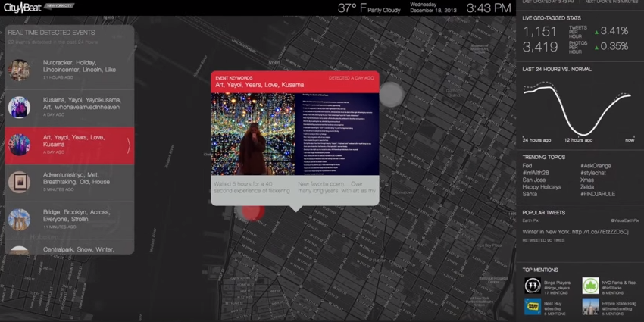
Readings
Editorial algorithms: using social media to discover and report local news
https://www.youtube.com/watch?v=ihMOIzeL9Mc
Notes:
https://www.youtube.com/watch?v=ihMOIzeL9Mc

Slide 28
Readings
Editorial algorithms: using social media to discover and report local news
What’s one possible definition of newsworthiness explored in the paper? What are challenges to getting algorithms understand what is newsworthy?
What are implications of only using Instagram data in the tool to detect events?
Notes:
Newsworthy as “unusual”
Challenges: different outlets have different definitions and audiences, different sets of SM inputs, geographic context / proximity may affect what’s newsworthy, ability to detect PR events.

Slide 29
Break

Slide 30
Tutorial
Social media analytics for
Conversation analysis
Content identification
Network analysis

Slide 31
Questions?
Don’t forget Pandas Bootcamp
Wed, 2/17, 5-8pm in Knight 3207

